Slide 1

Performance Analysis: OS for Multi-Robot Path Planning
A comparative study of Real-Time and General-Purpose Operating Systems using Ubuntu and Pardus.
Group Members :-
1) Ronit Ashnai
2) Tanay Bora
3) Krish Chandwani
4) Yash Chichria

Slide 2
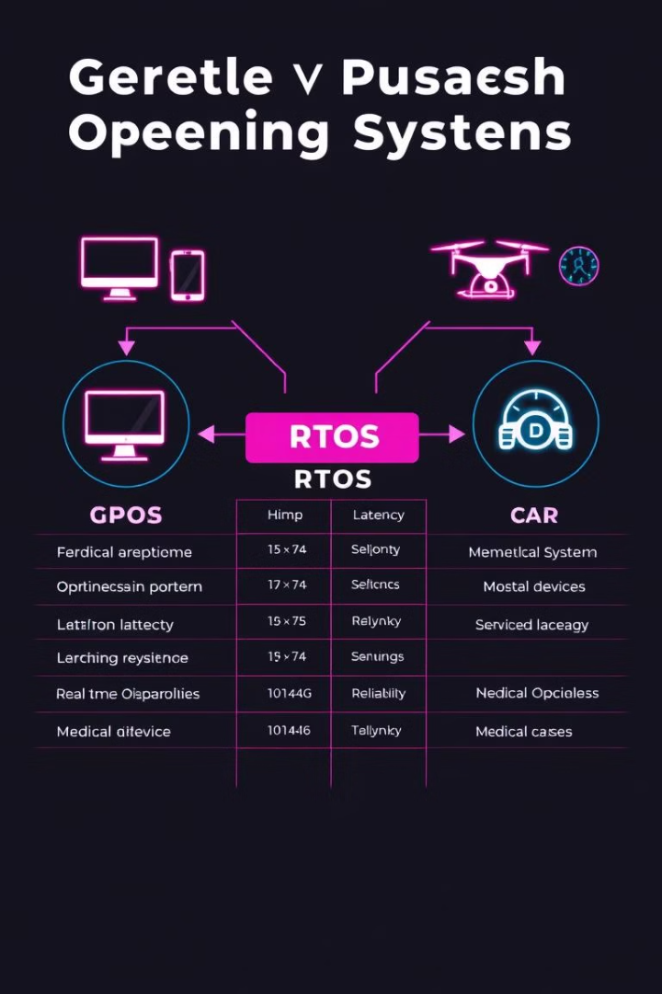
Introduction to Operating Systems in Robotics
1
Why OS Matters
2
GPOS vs. RTOS
Operating systems are key for robots. They manage hardware, schedule tasks, and run software. Without an OS, robots can't do complex tasks or work in their environment.
General-Purpose OS (GPOS) like Ubuntu work for many uses. Real-Time OS (RTOS) like Pardus are made for tasks needing quick timing. Choosing between them depends on how fast and sure the task must be.
3
Study Goal
This study checks how well GPOS (Ubuntu) and RTOS (Pardus) work for planning paths for many robots. Path planning needs good resource use and fast action, so the OS is very important.

Slide 3
Understanding GPOS and RTOS
GPOS
RTOS
High efficiency, multitasking, no strict task priority.
Time-critical, preemptive, categorized into soft, hard, and firm real-time.
General-Purpose Operating Systems (GPOS) are designed for a wide range of applications, from desktop computing to server management. They prioritize efficiency and multitasking, allowing users to run multiple applications simultaneously. However, they do not guarantee strict task priority, which can be a limitation for real-time applications.
Real-Time Operating Systems (RTOS) are specifically built for time-critical tasks where deterministic behavior is essential. They use preemptive scheduling to ensure that high-priority tasks are executed within strict time constraints. RTOS are categorized into soft, hard, and firm real-time based on the severity of consequences if deadlines are missed.
Examples: Windows, Linux, macOS
Suitable for applications where occasional delays are acceptable.
Examples: FreeRTOS, VxWorks, QNX
Essential for applications requiring precise timing and immediate response.

Slide 4

Research Objective and Motivation
Compare Ubuntu and Pardus
Focus
To evaluate the performance of Ubuntu, a General Purpose Operating System (GPOS), and Pardus, a Real-Time Operating System (RTOS), in the context of multi-robot path planning.
Specifically focusing on path planning and formation control algorithms within multi-robot systems to understand the impact of OS characteristics on overall system performance.
Motivation
Driven by the inherent time dependency in robotics applications, where timely execution of tasks is critical for safety and efficiency. This research aims to quantify the performance differences and provide insights for selecting the appropriate OS.

Slide 5




Research Methodology
Two Linux Distributions
Configurations
Tool
Ubuntu 20.04 was chosen as the General Purpose Operating System (GPOS), known for its versatility and wide adoption. Pardus, a Real-Time Operating System (RTOS), was selected for its deterministic performance and suitability for time-critical applications.
Both Ubuntu and Pardus were configured to highlight their key capabilities. Ubuntu was set up to represent a typical desktop environment, while Pardus was optimized for real-time task scheduling to ensure minimal latency.
Robot Operating System (ROS) was used as the primary framework for developing and simulating the multi-robot path planning algorithms. The turtlesim environment within ROS provided a simplified yet effective platform for testing and comparing the performance of the two operating systems.

Slide 6




Experiment 1: Drawing the Pardus Logo
Task
Utilize a multi-robot system to draw the Pardus logo within the turtlesim environment. This involves coordinating multiple robots to follow a predefined path that accurately replicates the logo's design, assessing the feasibility and precision of the path planning algorithms.
Systems
Compare the performance of Ubuntu 20.04, configured as a General Purpose Operating System (GPOS), against Pardus, a Real-Time Operating System (RTOS). Both systems are tested under similar conditions to highlight the impact of OS scheduling on the robots' ability to maintain formation and adhere to the planned path.
Metrics
Evaluate the systems based on CPU usage, which indicates the computational load on the processor, and processing time, which measures the duration required to complete the logo drawing task. These metrics will reveal the efficiency and real-time capabilities of each operating system in managing multi-robot tasks.

Slide 7
Experiment 2: Drawing the Ubuntu-Linux Logo
Task
1
Coordinate the multi-robot system to accurately draw the Ubuntu-Linux logo within the turtlesim environment. This involves precise path planning and execution to replicate the logo's design.
Systems
2
Utilize Ubuntu 20.04 as a General Purpose Operating System (GPOS) and Pardus as a Real-Time Operating System (RTOS), testing both under similar conditions to compare their performance.
Metrics
3
Evaluate CPU usage to measure the computational load and processing time to assess the duration required for the logo drawing task, highlighting the efficiency of each OS.

Slide 8

Results: Processing Time Comparison
61.89
68.94
76.70
Ubuntu GPOS
Ubuntu RTOS
Pardus GPOS
Fastest processing time (ms).
Slightly slower than GPOS (ms).
Slower than Ubuntu GPOS (ms).

Slide 9
Results: CPU Usage and Key Observations
RTOS (Pardus)
Ubuntu GPOS
Significantly lower CPU usage compared to GPOS, indicating efficient resource management. This is due to the real-time scheduling capabilities of RTOS, which prioritize critical tasks and minimize overhead. The reduced CPU load contributes to more predictable performance and better responsiveness in multi-robot coordination.
Demonstrated the lowest processing time but exhibited moderate CPU usage. While GPOS provides a faster average processing time, its CPU usage fluctuates more due to its general-purpose scheduling, which balances various system processes. This can lead to occasional performance spikes and less predictable behavior in real-time applications.
Efficient Resource Management
Faster Average Processing Time
Predictable Performance
Fluctuating CPU Usage
Better Responsiveness
Less Predictable Behavior

Slide 10
Discussion: Implications of Findings
1
GPOS: Speed Matters
2
RTOS: Reliability is Key
3
Ubuntu: Superior Performance
GPOS excels in speed, making it suitable for tasks that are performance-driven and require quick processing times. Its general-purpose nature allows it to handle a variety of tasks efficiently, but this can sometimes come at the cost of predictability.
RTOS ensures reliability, which is crucial for time-dependent applications where precision is essential. Its real-time scheduling capabilities prioritize critical tasks, minimizing overhead and ensuring consistent performance, even under heavy load.
Ubuntu outperforms Pardus in both GPOS and RTOS configurations during testing. This suggests that Ubuntu's kernel and system-level optimizations provide a performance advantage, regardless of the operating system type. However, the specific advantages of RTOS in terms of resource management should still be considered for real-time applications.

Slide 11
Conclusion
1
Speed vs. Reliability
2
Ubuntu's Edge
3
Choose Wisely
GPOS excels in speed, making it ideal for applications where rapid processing is paramount. RTOS, on the other hand, prioritizes reliability, ensuring consistent and predictable performance in critical operations where precision is essential.
Ubuntu consistently outperforms Pardus in our tests, demonstrating superior performance in both GPOS and RTOS setups. This suggests that Ubuntu's optimized kernel and system-level architecture provide a performance advantage regardless of the operating system type.
Select GPOS for tasks where performance and quick processing times are crucial, such as simulations or high-frequency data analysis. Choose RTOS for safety-critical roles, such as robotics control systems or medical devices, where reliability and predictability are paramount.

Slide 12

Acknowledgements and References
We would like to thank all the individuals and institutions that supported this research. Special thanks to [Funding Source] for their generous financial support, and to [Lab/Institution] for providing the resources and equipment necessary for our experiments. We also acknowledge the contributions of [Individual Contributors] for their invaluable assistance and insights.
References:
Performance analysis of real-time and general-purpose operating systems for path planning of the multi-robot systems | ScienceGate

